Slide 1
Diabetes diagnosis
model
Iñaki Cabo
Mariana Pérez-Cong
Bruno López

Slide 2

Diabetes
It affects 347 million people in the world
Three billion dollars yearly invested in care
Untreated, it can lead to kidney damage, eye damage, heart disease and even death.
Notes:
In Mexico diabetes is the number one cause of death

Slide 3

Our solution
Build a model in which given eight simple features, it can determine if a patient has diabetes.
Value:
No need of lengthy and expensive tests
Motivate people to be more aware of their health
Reduce deaths from untreated diabetes

Slide 4
Data set: Pima Indians Diabetes database
Pregnancies: number of pregnancies
Glucose: Plasma glucose concentration (Test)
Blood Pressure: Pressure in the arteries when the heart rests between beats
Skin Thickness: Triceps skin fold thickness (body fat)
Insulin: 2 hour serum insulin
BMI: body mass index
Diabetes Pedigree Function: Likelihood of diabetes based on family history.
Age: Subject’s age

Slide 5
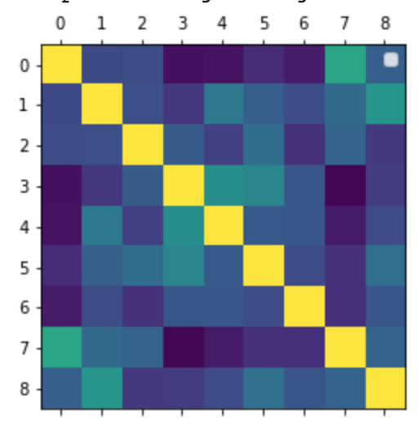
Exploratory Data Analysis: Correlation matrix
0-Pregnancies
1-Glucose
2-Blood Pressure
3-Skin Thickness
4-Insulin
5-BMI
6-Diabetes Pedigree Function
7-Age
8-Outcome
Notes:
Pregnancies is correlated with SkinThickness, Insulin and Diabetes PedigreeFunction?
Age is correlated with SkinThickness, Insulin?

Slide 6
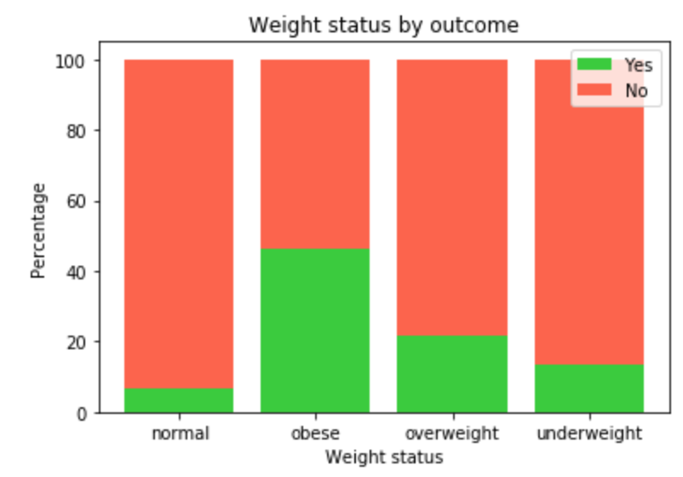
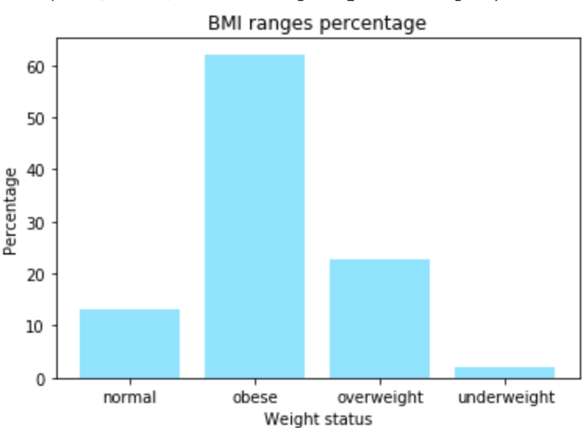
Exploratory Data Analysis: BMI

Slide 7
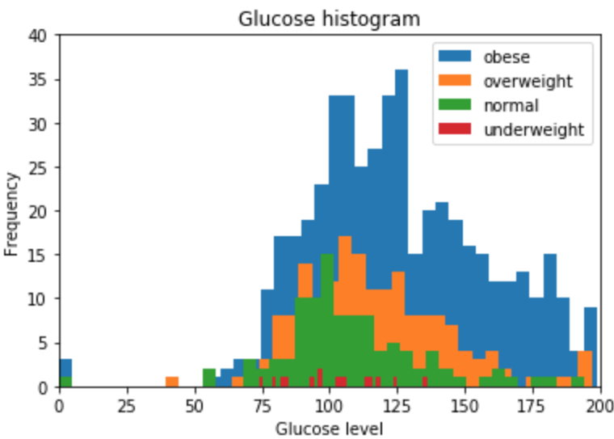
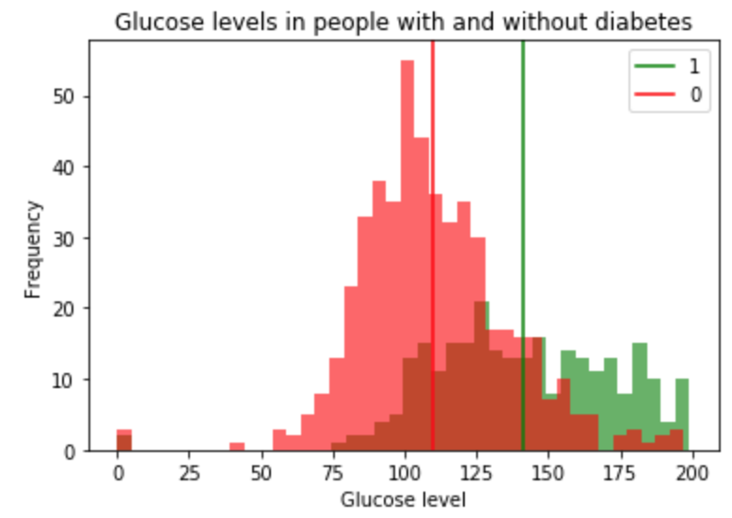
Exploratory Data Analysis:Glucose

Slide 8
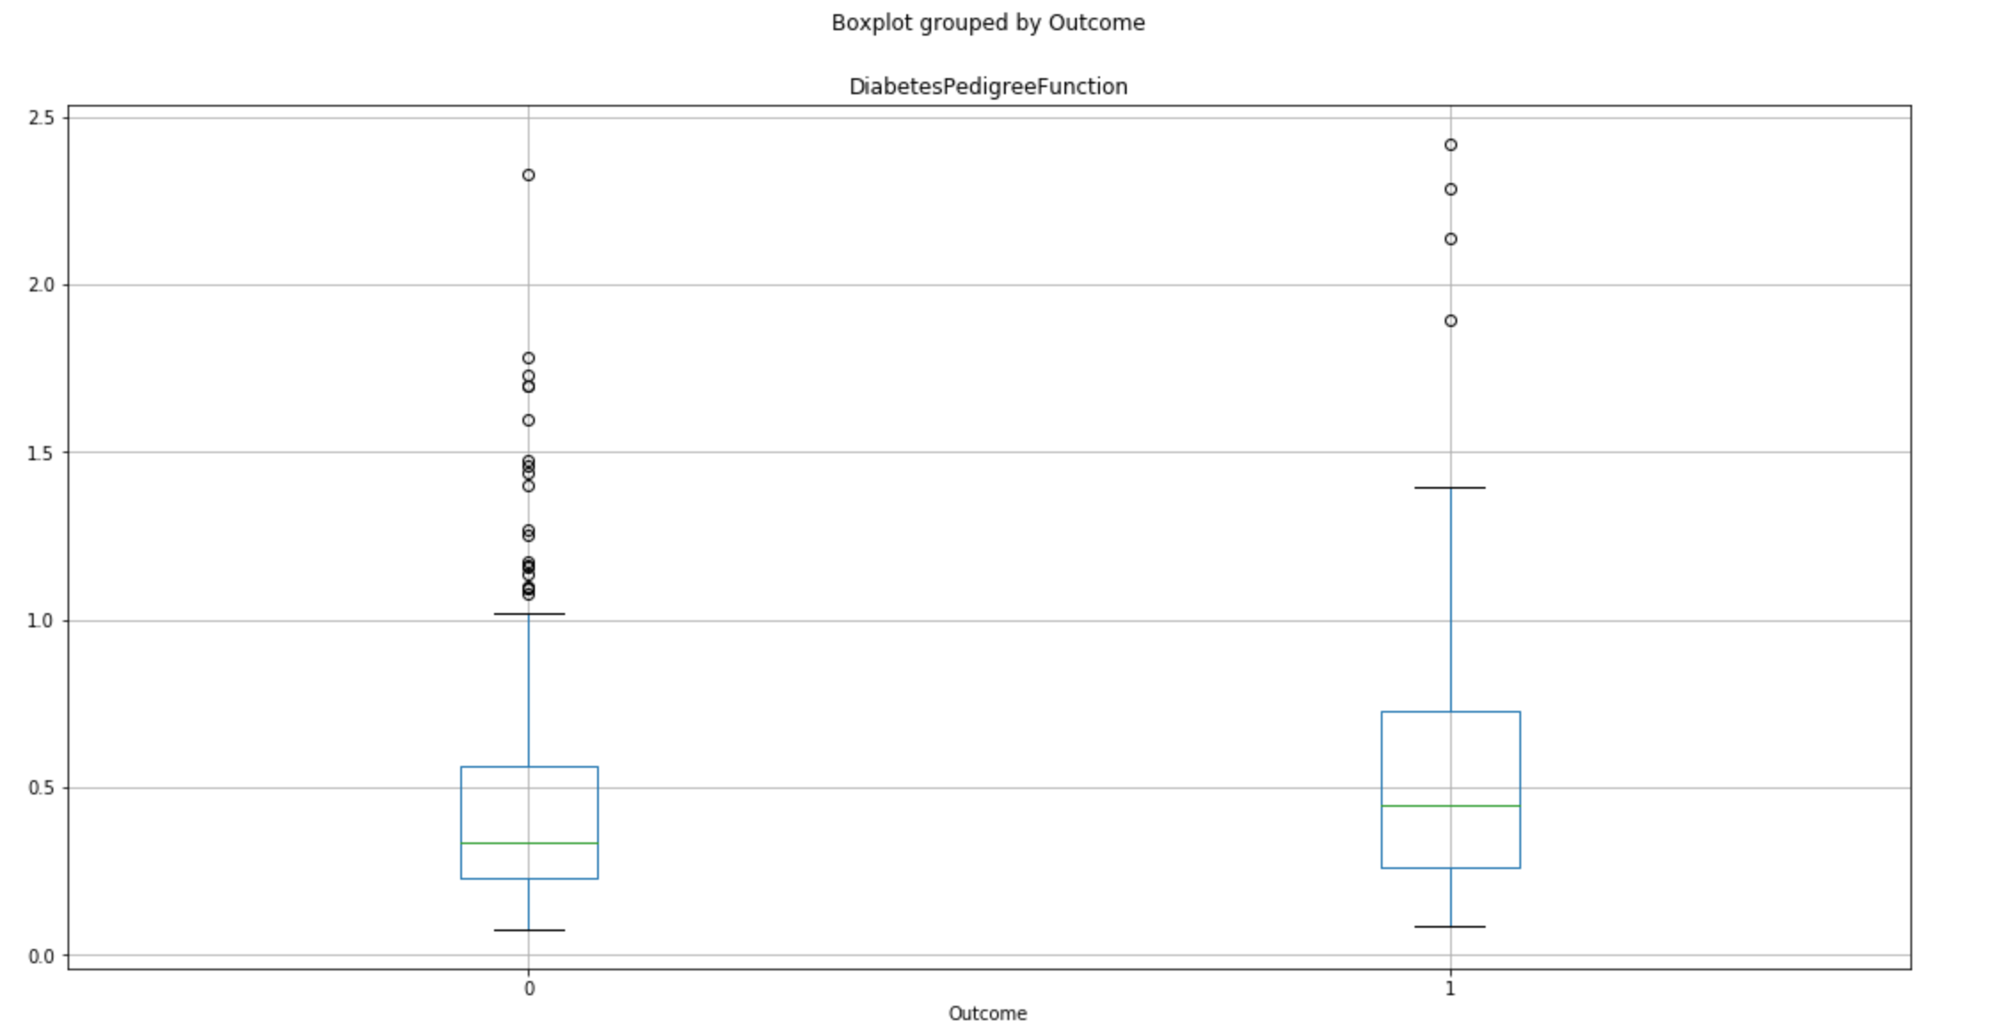
Exploratory Data Analysis: Genetics

Slide 9
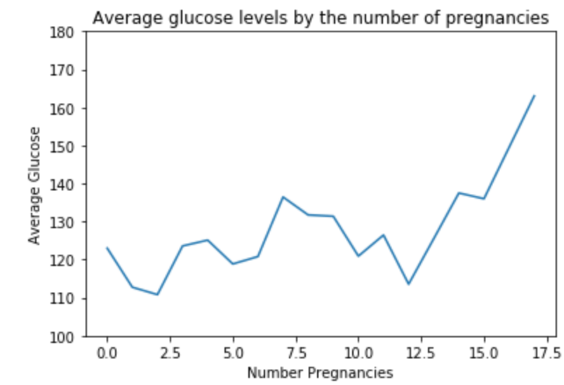
Exploratory Data Analysis: Pregnancies

Slide 10
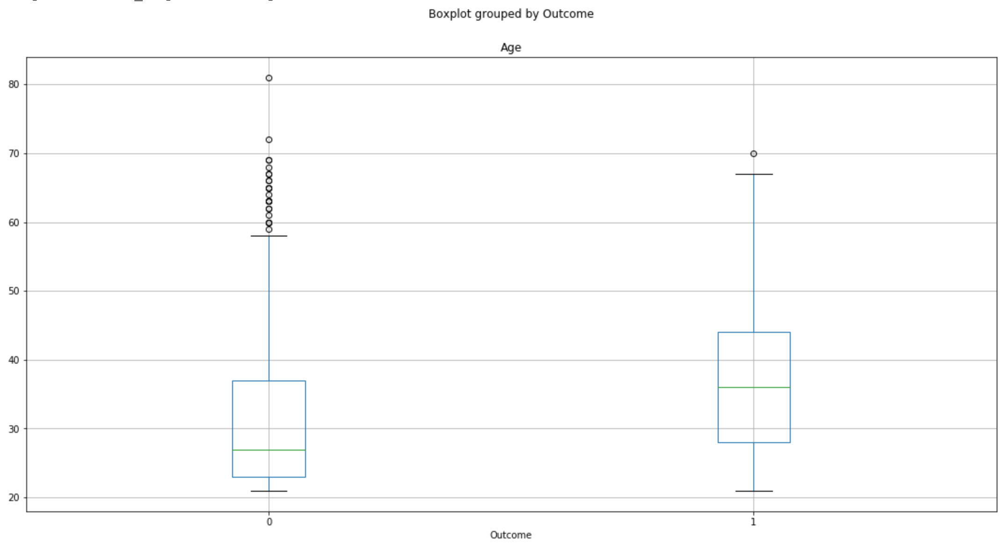
Exploratory Data Analysis: Age

Slide 11
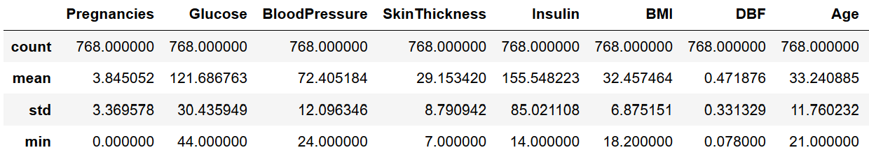
Imputation
Analyze the contents of each column (Percentage of 0 values):
Insulin: 48.7%
Skin Thickness: 30%
Pregnancies: 14.5%
Impute the mean of the values into where 0 were found in every column except Pregnancies.
Notes:
Then we scaled the data

Slide 12
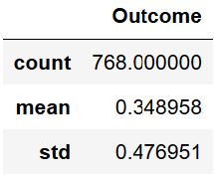
Undersample? Oversample?
Out of 768 observations:
500 don’t have diabetes
268 have diabetes.
We want the sample to be equally splitted, so we don’t introduce bias to the model.
Options:
Undersample (Remove 232 random observations from people that don’t have diabetes)
Oversample

Slide 13
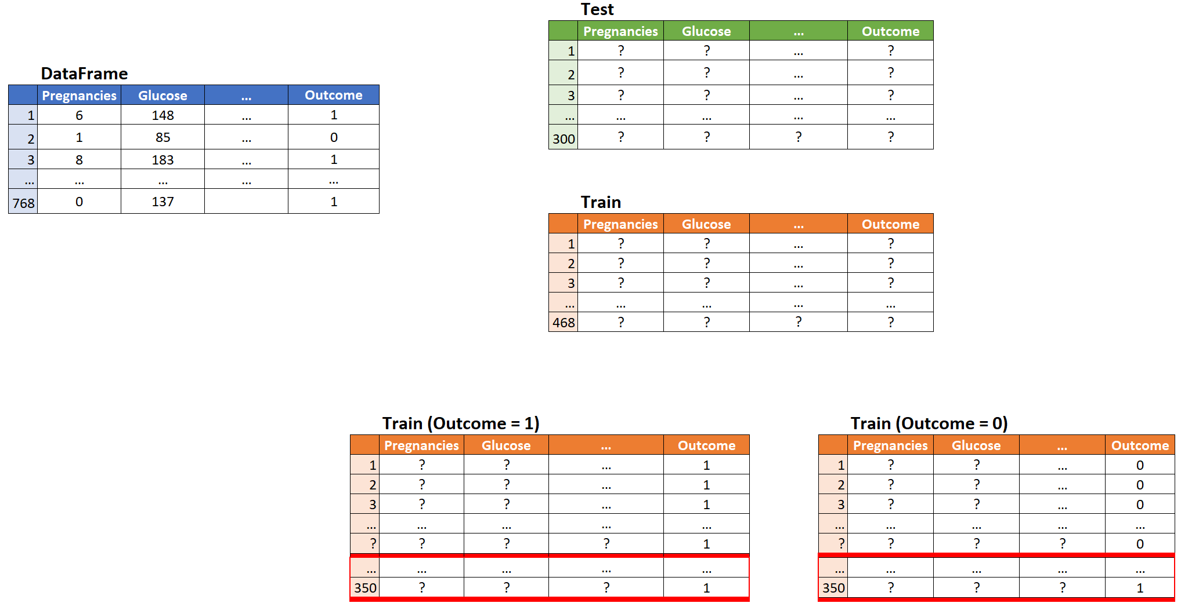
Oversampling {
random sample

Slide 14
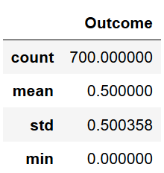
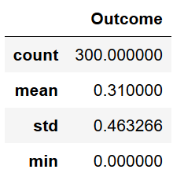
Final DataFrames
Train: Test:

Slide 15
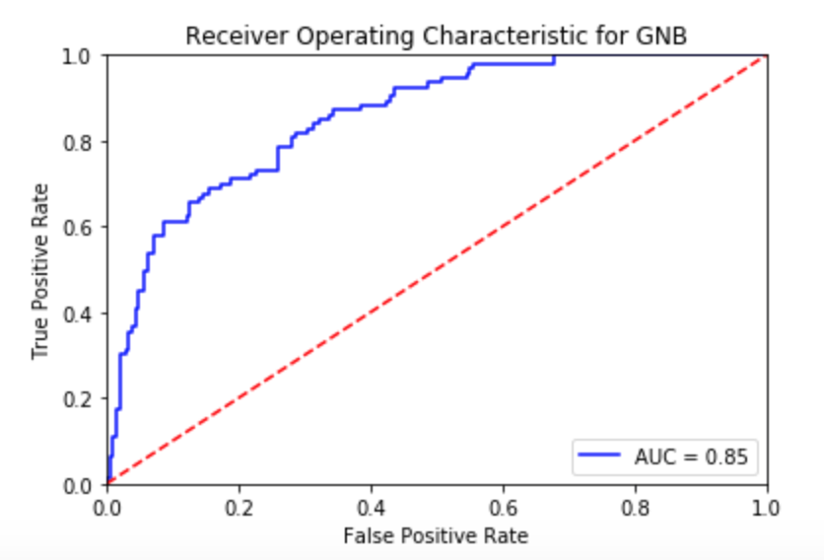
Naive Bayes
10 fold cross validation to select best model.
Models used:
Gaussian
Multinomial
Bernoulli
Selected Gaussian Naive Bayes (mean score of 72.43%)
Notes:
AUC represents degree or measure of separability. It tells how much the model is capable of distinguishing between classses. Higher the AUC, better.
GaussianNB implements the Gaussian Naive Bayes algorithm for classification. The likelihood of the features is assumed to be Gaussian:
MultinomialNB implements the naive Bayes algorithm for multinomially distributed data, and is one of the two classic naive Bayes variants used in text classification (where the data are typically represented as word vector counts, although tf-idf vectors are also known to work well in practice).
BernoulliNB implements the naive Bayes training and classification algorithms for data that is distributed according to multivariate Bernoulli distributions; i.e., there may be multiple features but each one is assumed to be a binary-valued (Bernoulli, boolean) variable.

Slide 16
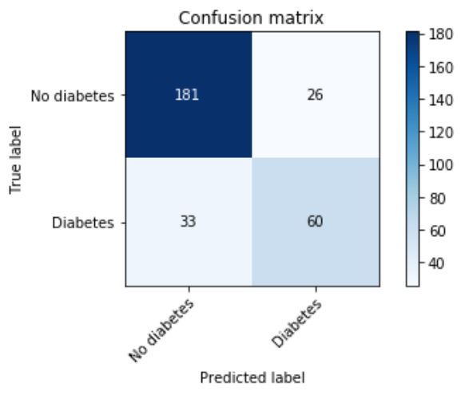
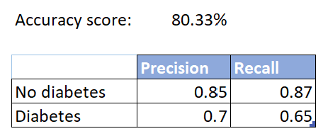
Gaussian Naive Bayes
Notes:
We correctly identify 65% of diabetics and 87% of non diabetics.
Precision: Accuracy of positive predictions
Recall (aka sensitivity or true positive rate): Fraction of positives that were correctly identified.
F1 Score (aka F-Score or F-Measure) – A helpful metric for comparing two classifiers. F1 Score takes into account precision and the recall. It is created by finding the the harmonic mean of precision and recall.
F1 = 2 x (precision x recall)/(precision + recall)

Slide 17
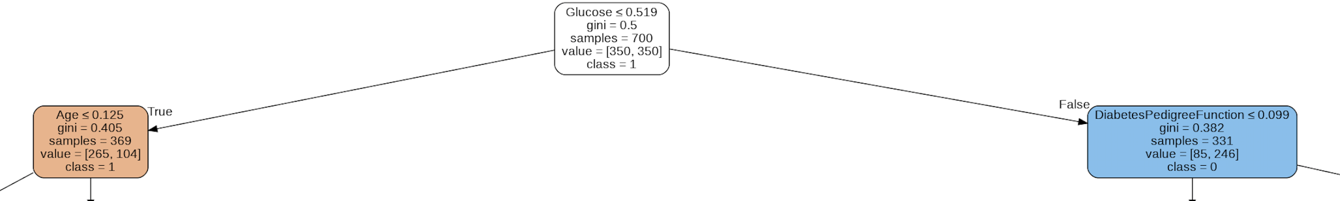
Decision Tree
Accuracy: 67.3%
The main features that we got when creating our decision tree were:
Glucose
Age
Genetic heritage
Notes:
Decision tree
Feature importances:
1. Glucose 32.04%
2. Age 15.75%
3. DiabetesPedigreeFunction 13.71%
4. BMI 13.18%
5. Insulin 9%
6. Blood Pressure 7%
7. SkinThickness 8.8%
8. Pregnancies 3.5%

Slide 18
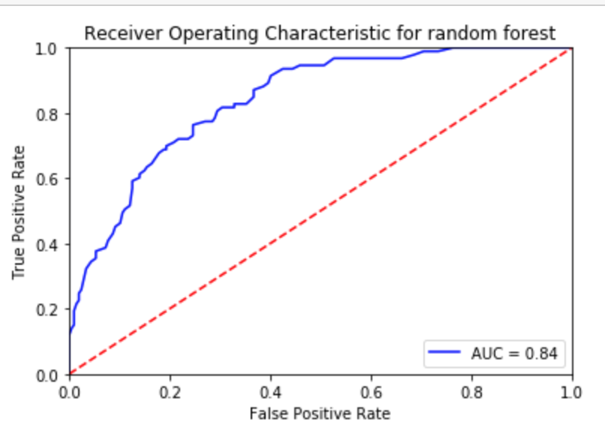
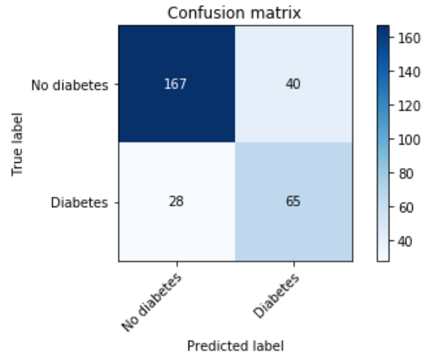
Random Forest
The accuracy we achieved when training this model was 77%

Slide 19

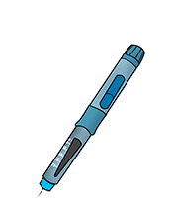

Takeaways
vs
Notes:
Diabetes en mujeres es distinta a la diabetes en hombres

